Slide 1
JUPITER
What is it about?

Slide 2
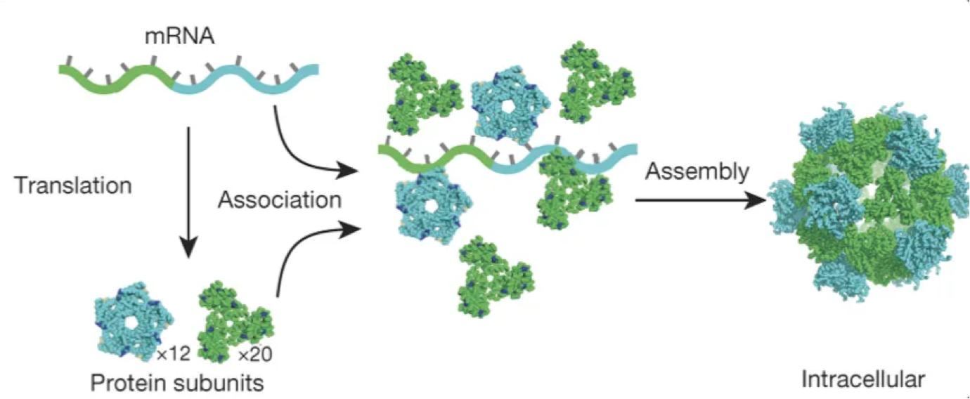
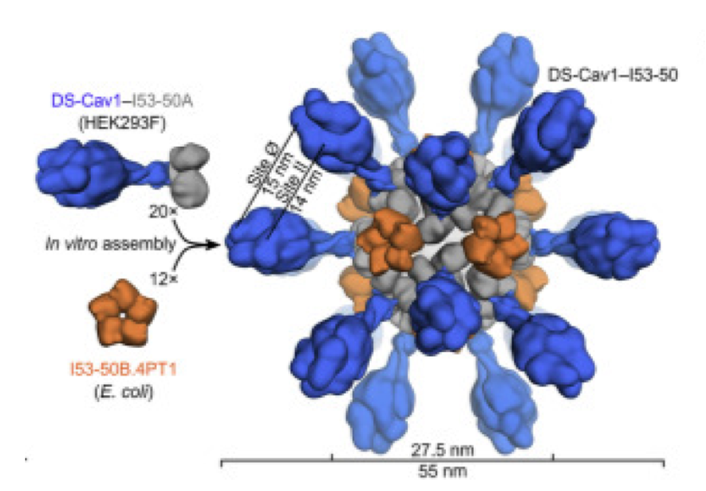
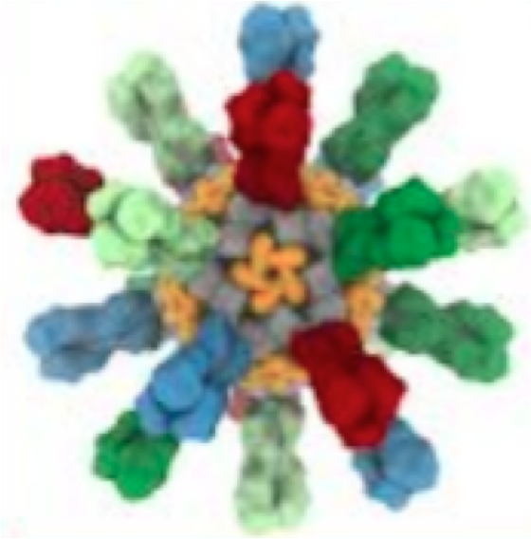
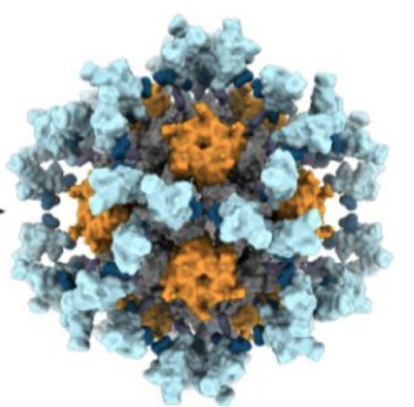
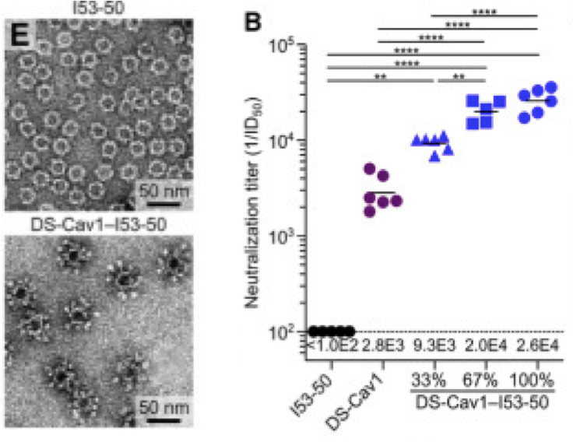
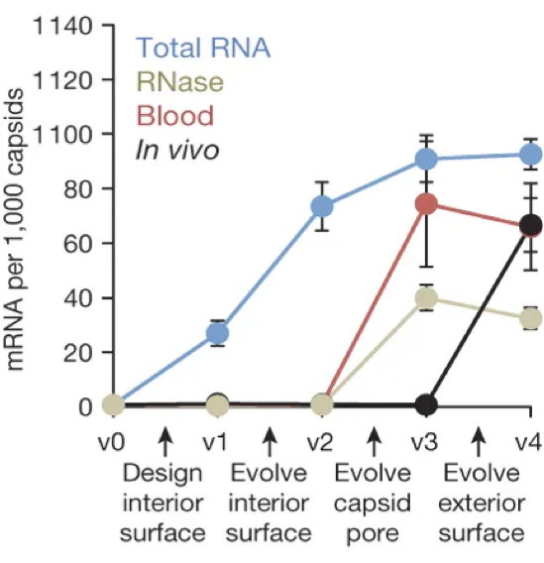
The project - Why protein nanoparticles?
Versatile platforms for antigen display
(e.g. vaccine development)
Cargo encapsulation
(e.g. targeted delivery)
Respiratory syncytial virus
(Ds-Cav-1)
Flu
(Hemaglutinin)
SARS-CoV-2
(Receptor binding domain)
Marcandalli and Fiala et al. (2019) Cell 176, 1420;
Boyoglu-Barnum and Ellis et al. (2020) Nature (in revision);
Walls and Fiala et al. (2020) Cell doi: 10.1016/j.cell.2020.10.043 Butterfield et al. (2017) Nature 552, 415

Slide 3
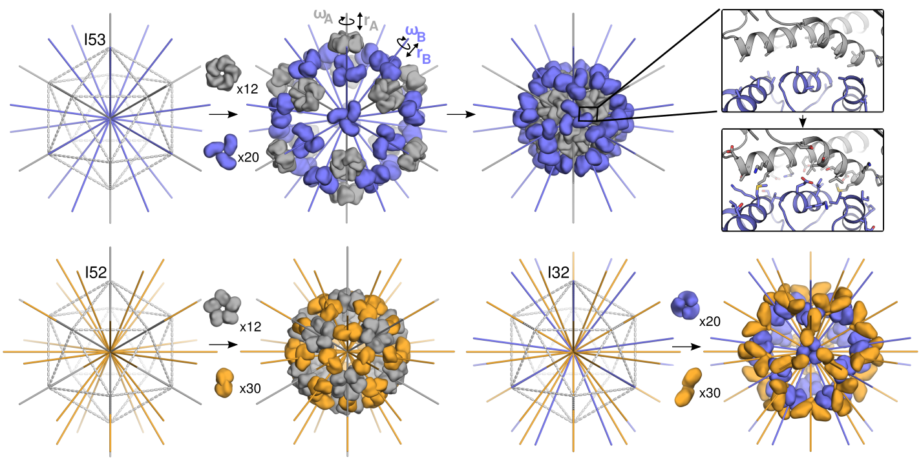
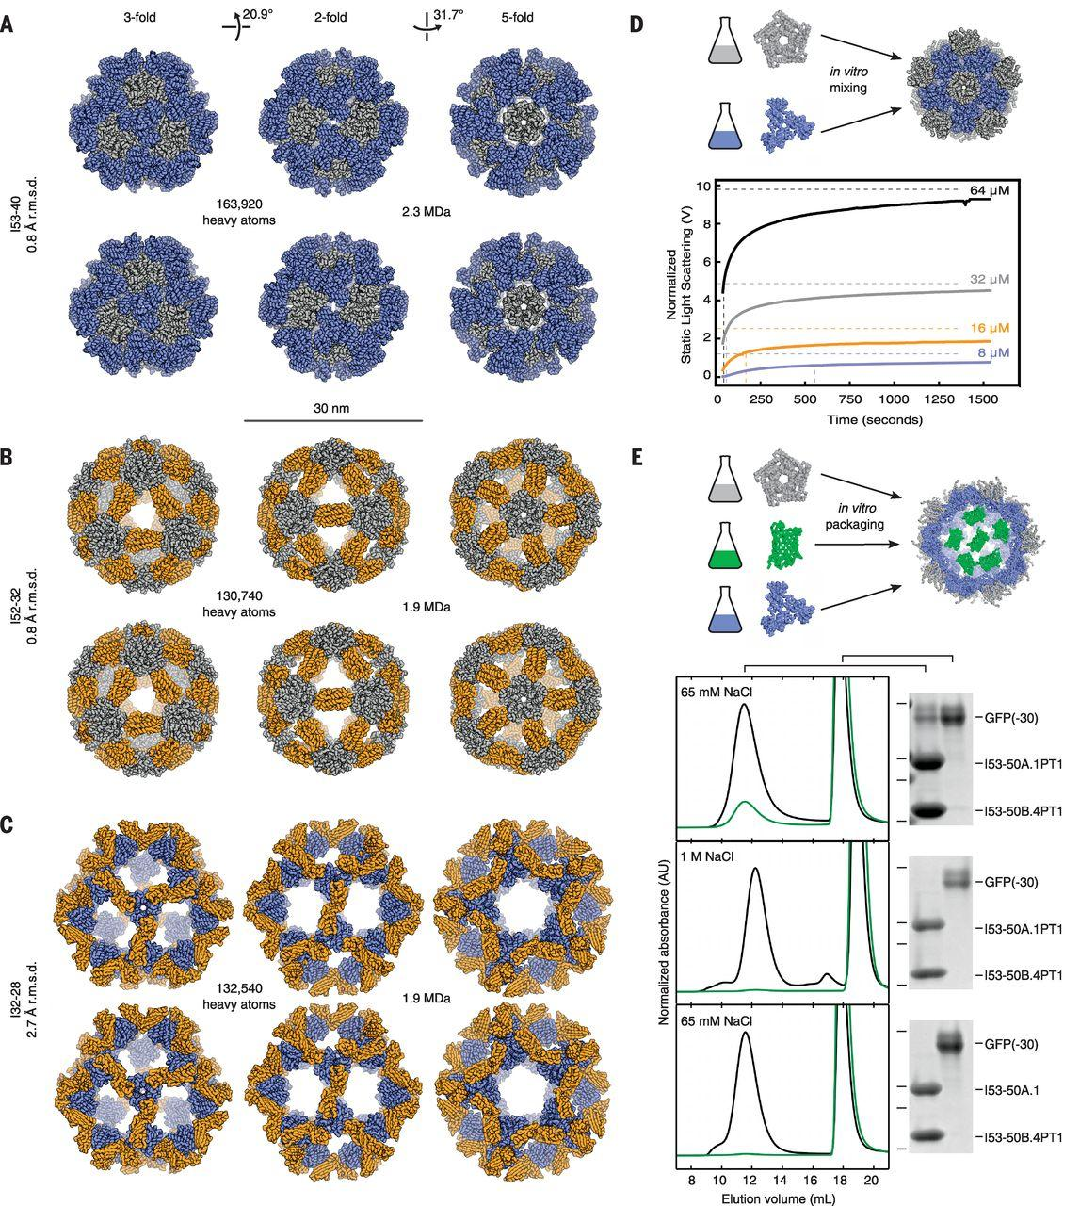
The project - How can we design and test de novo protein nanoparticles?
1. Identify symmetry group of interest
2. Dock fitting scaffolds
3. Design interface
King et al. (2012) Science 336, 1171; King et al. (2014) Nature 510, 103;
Hsia et al. (2016) Nature 535, 136; Bale et al. (2016) Science 353, 389

Slide 4

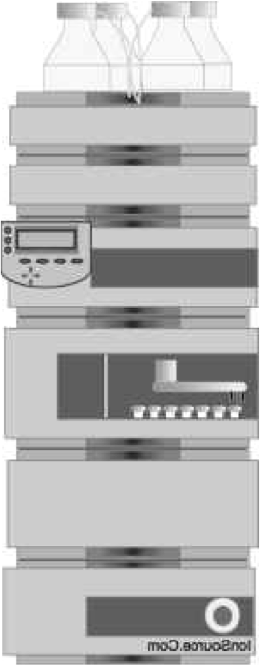


The project - How can we design and test de novo protein nanoparticles?
Aminoacid sequence
Synthetic gene
Protein expression
Protein purification
and characterization

Slide 5
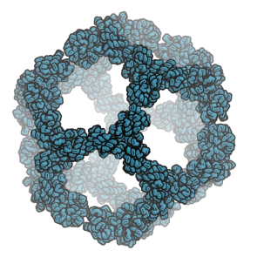
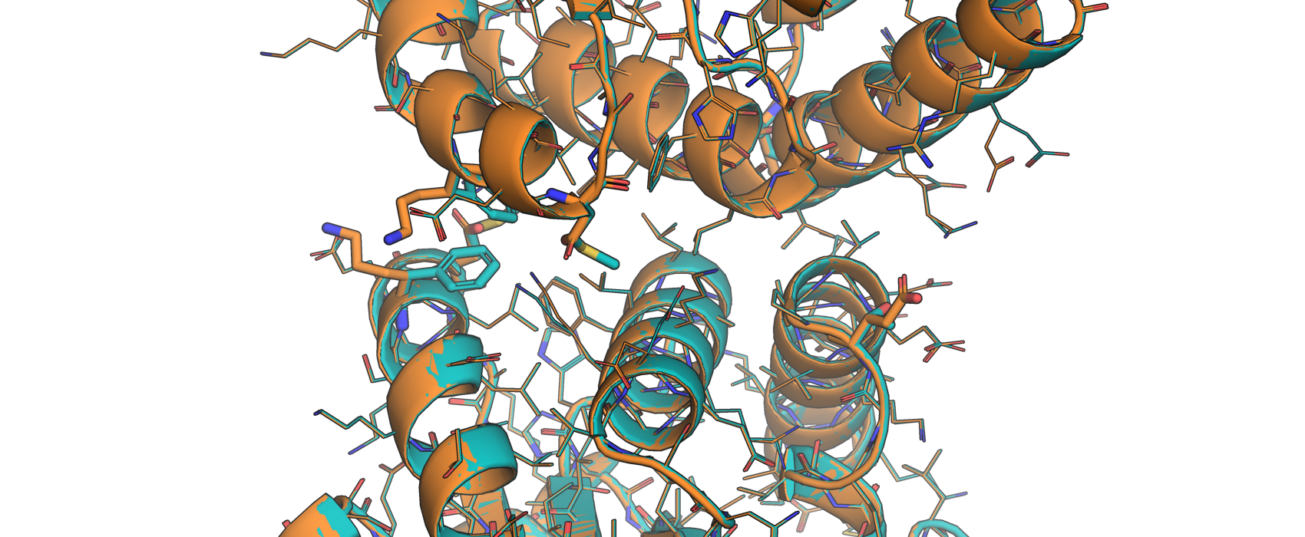
The project - Low confidence in success prediction in current design pipeline
E.g. I3-01 (Hsia et al. (2016) Nature 535, 136) and it’s children
I3-01 vs I3-71
F55K
M59D
T183E
Provided by Erin Yang

Slide 6
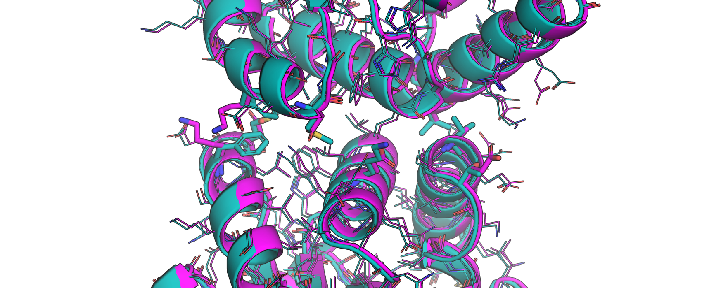
The project - Low confidence in success prediction in current design pipeline
E.g. I3-01 (Hsia et al. (2016) Nature 535, 136) and it’s children
I3-01 vs I3-70
K24E
F55K
M59D
T183E
V185A
Provided by Erin Yang

Slide 7
The project - Low confidence in success prediction in current design pipeline
E.g. I3-01 (Hsia et al. (2016) Nature 535, 136) and it’s children
Design | 23 | 24 | 31 | 52 | 55 | 59 | 183 | 185 | 188
1wa3 | K | E | E | E | F | K | T | D | R
I3-01 | K | K | L | E | F | M | T | V | A
I3-71 | K | K | L | E | K | D | E | V | A
I3-72 | E | K | L | N | F | K | T | I | A
I3-69 | K | E | L | D | K | D | E | D | A
I3-70 | K | E | L | E | K | D | E | A | A
Provided by Erin Yang

Slide 8
The project - Goal
Identify positions at the interface of working designs that allow us to control their stability
Determine the effect of point mutations at the protein-protein interface on canonical design metrics
Identify key residue position predicted to weaken/strengthen the protein-protein interface

Slide 9
The format
Week | Goal
1 | Introduction to JUPITER. How to read a scientific paper?
2 | Paper discussion. Introduction to Foldit and tutorial.
3 | How to do mutation scanning using Foldit?
4 | Basics of bash/Rosetta scripts
5 | Writing a Rosetta script that does mutation scanning for a cage interface
6 | How to analyze Rosetta outputs
7 | How to effectively present your data?
8 | Presentation and discussion

Slide 10
The format
Lectures/tutorials - Tuesday 08.30-09.30 am (also available online)
Homeworks - on your own time
Virtual office hours - upon interest, Wednesday 10.30-11.00 am and
Friday 02.30-03.00 pm

Slide 11
Questions ?

